Slide 1
Hemodynamic Fluent Calculation Guide
By: Asad Mirza
For: CV-PEUTICS

Slide 2
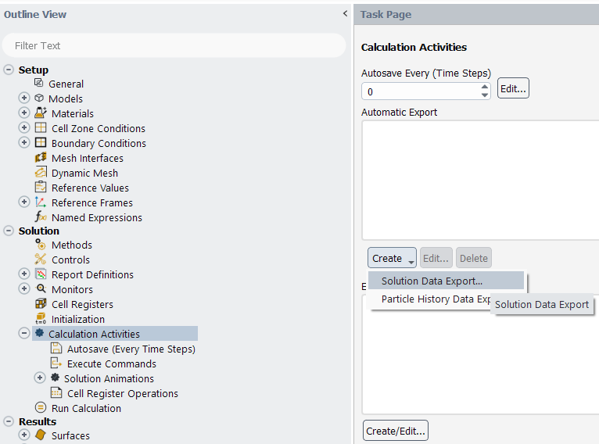
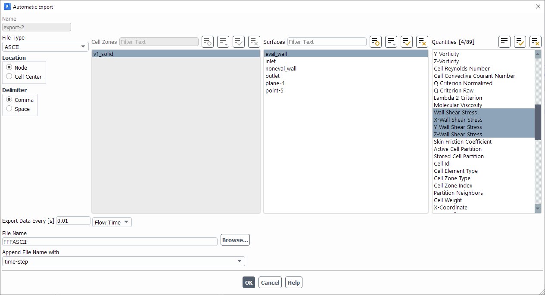
Setting Up Fluent Export
Calculation Activities → Create → Solution Data Export
File Type: ASCII
Location: Node
Delimiter: Comma
Surface: Surface whose OSI/TAWSS you’re interested in
Quantities: Wall Shear Stress and XYZ Wall Shear Stress

Slide 3
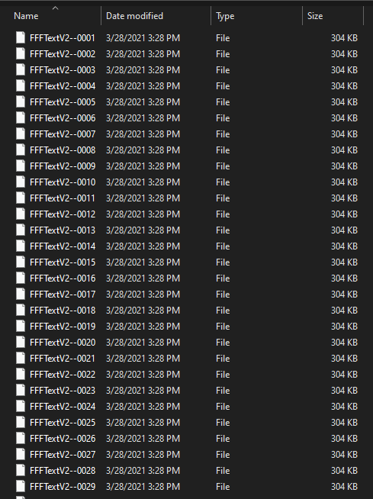
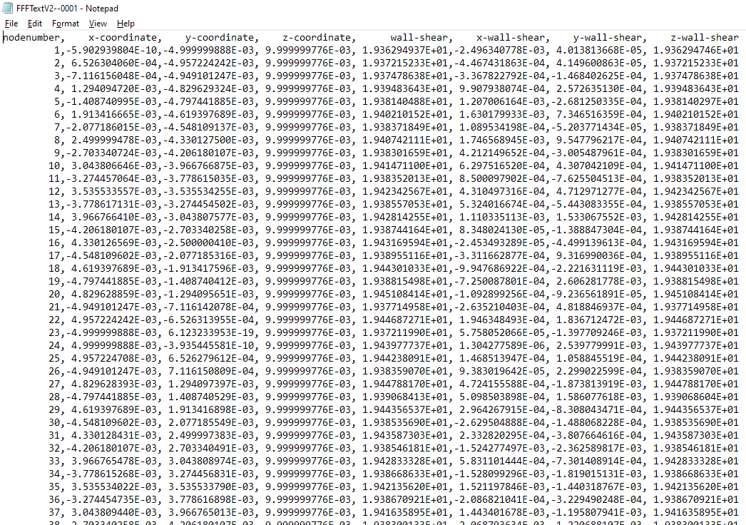
Exported Data

Slide 4
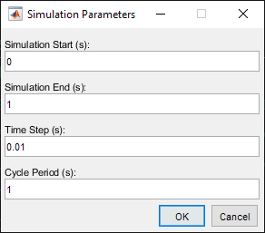
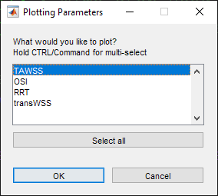
Post-Processing: Setting Parameters
The MATLAB script titled “Fluent_Post_Processing.m” must be run to process the exported data.
It will ask you for the following:
Simulation Start Time
Simulation End Time
Time Step Size
Cycle Period
You will then be asked which results you wish to plot: TAWSS, OSI, RRT, or transWSS

Slide 5
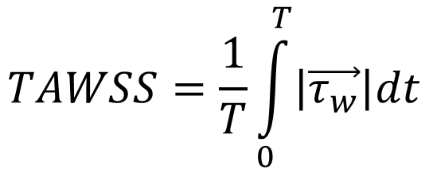
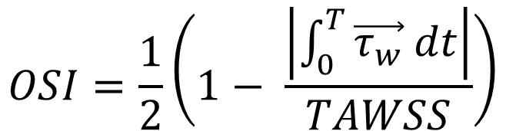
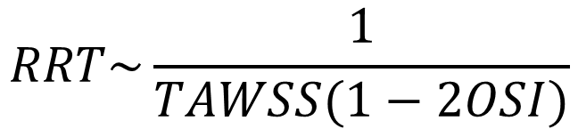
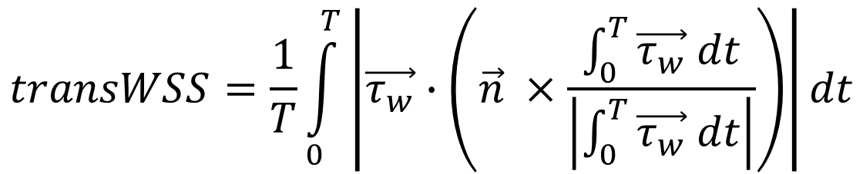
Post-Processing: TAWSS/OSI/RRT/transWSS
$$TAWSS=\frac{1}{T}\int_{0}^{T}{\left|\vec{τ_{w}}\right|dt}$$
$$OSI=\frac{1}{2}\left(1− \frac{\left|\int_{0}^{T}{\vec{τ_{w}} dt}\right|}{TAWSS}\right)$$
Measures average of the degree of forward/backward fluid movement over time.
Measures average WSS on a surface over time.
$$transWSS=\frac{1}{T}\int_{0}^{T}{\left|\vec{τ_{w}}∙\left(\vec{n} ×\frac{\int_{0}^{T}{\vec{τ_{w}} dt}}{\left|\int_{0}^{T}{\vec{τ_{w}} dt}\right|}\right)\right|dt}$$
$$RRT\sim \frac{1}{TAWSS(1−2OSI)}$$
Measures a fluid particle’s relative time spent in a particular location on fluid surface over time.
Measures multidirectional WSS on a surface over time.

Slide 6
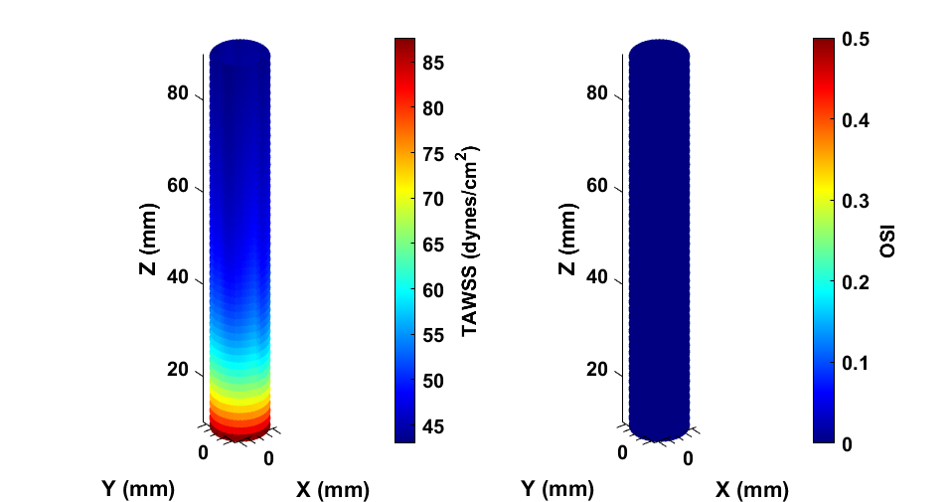
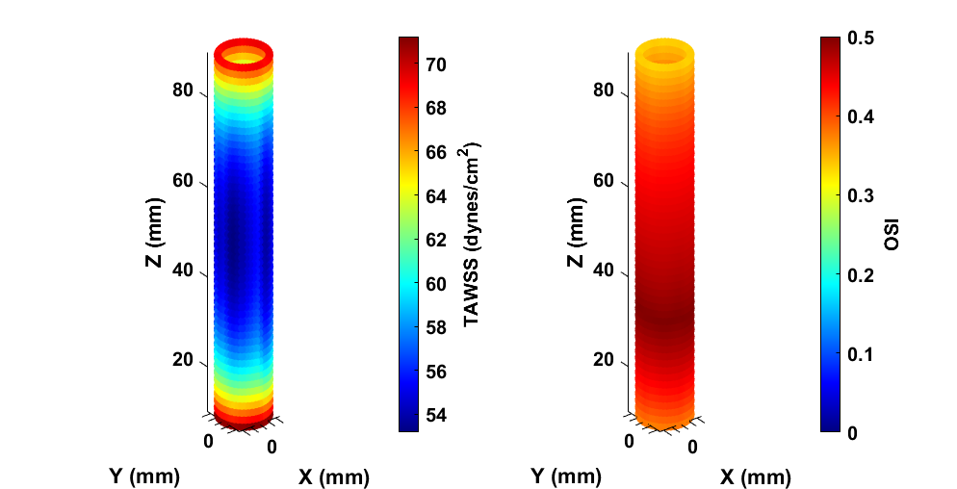
Post-Processing: TAWSS/OSI Plotting
Ex: +1 m/s Inlet
Ex: +/- 1 m/s Inlet

Slide 7
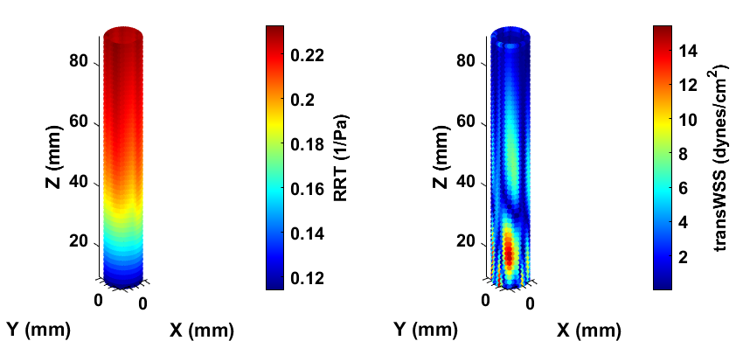
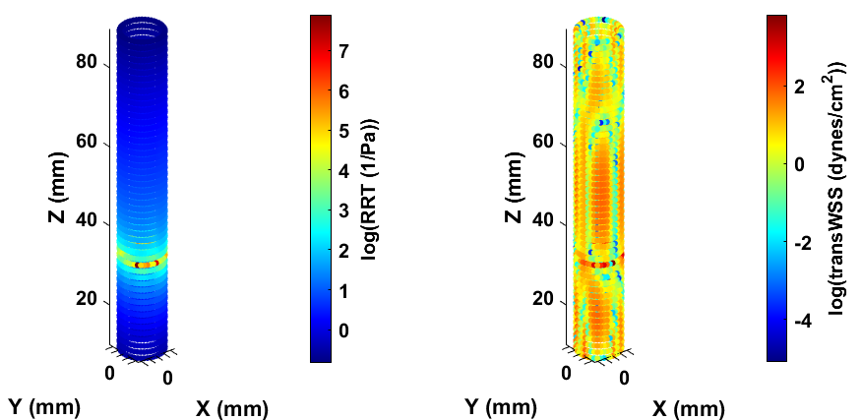
Post-Processing: RRT/transWSS
Ex: +1 m/s Inlet
Ex: +/- 1 m/s Inlet

Slide 8
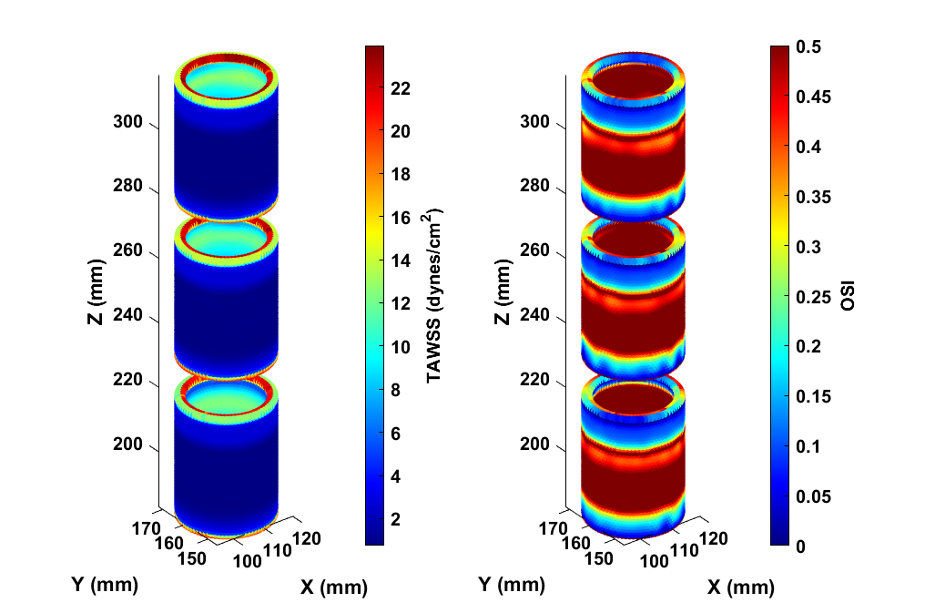
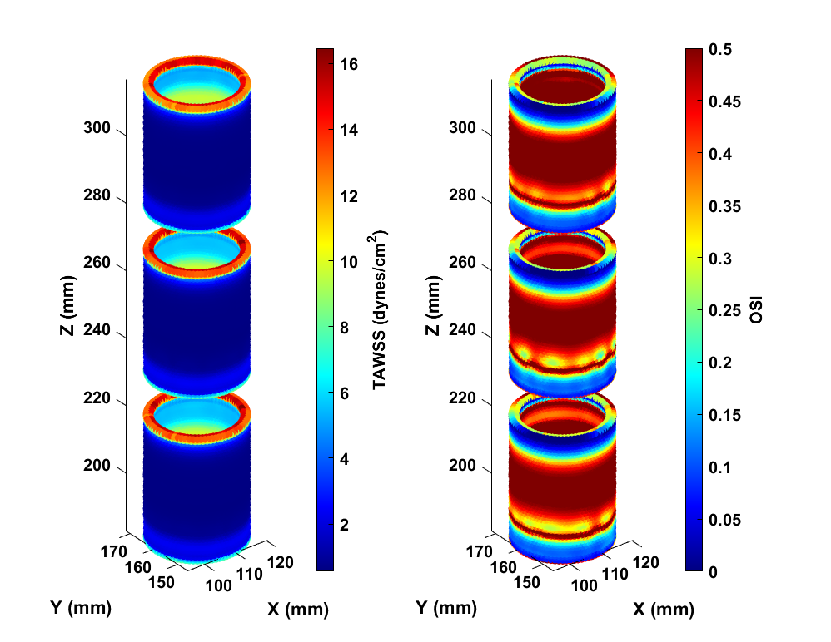
Post-Processing: More Examples (TAWSS/OSI)
Ex: S35/4 Waveform
Ex: Inlet Squared by 4 Waveform

Slide 9
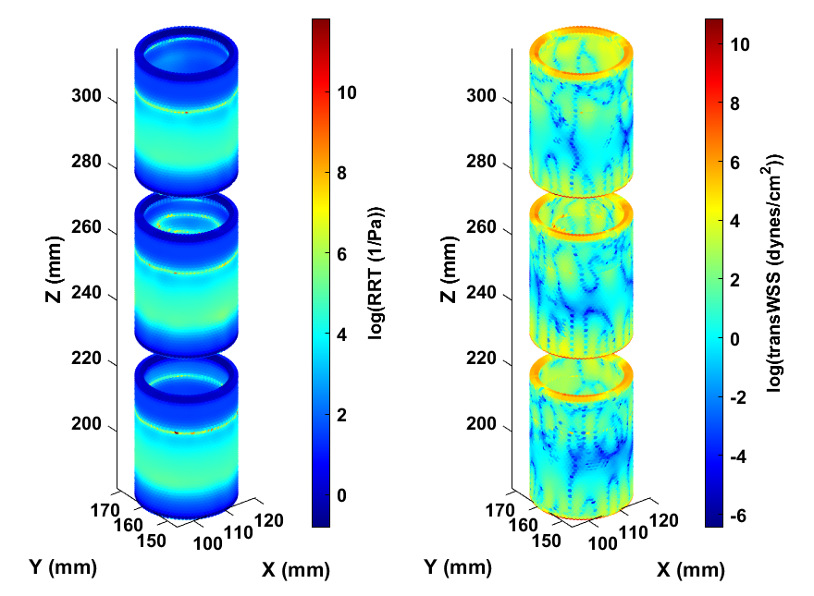
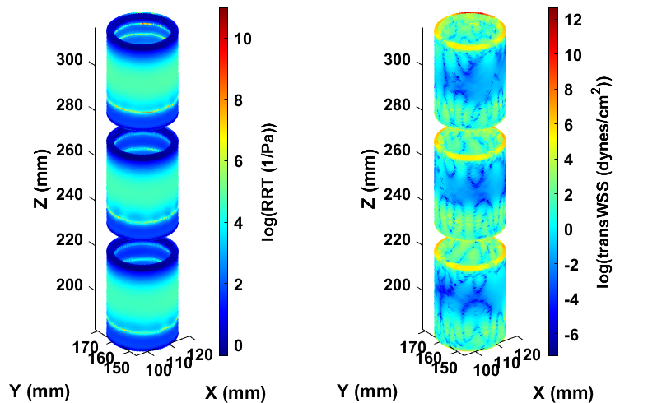
Post-Processing: More Examples (RRT/transWSS)
Ex: S35/4 Waveform
Ex: Inlet Squared by 4 Waveform

Slide 10
Future Improvements
Proper surface/element plotting rather than point cloud
Faster processing of many points
Reporting of Average +/- Standard Deviation for the exported surface
Creation of interactive GUI to simplify data processing.
Export GUI as exe to allow function outside of MATLAB

